Slide 1
CLIENT Business Agility
Benefits, Approach, and Implementation

Slide 2
Benefits of the Agile Enterprise
Supports Growth, Operator Relations, & Employee Engagement Leading To High Performance
FORM INDEPENDENT TEAMS WITH A BIAS FOR ACTION through fully allocating resources to small cross-functional teams led by an empowered team leader focused on the most important work.
LEVERAGE THE COLLECTIVE SKILLS, EXPERIENCE AND TALENT ACROSS THE ENTERPRISE through more effective collaboration enabled by focused teams, visibility, and role clarity.
DELIVER HIGHER-IMPACT RESULTS leveraging increased visibility of work being released in smaller testable increments.
INCREASE THE SPEED AND EFFICIENCY OF HOW WE WORK AND MAKE DECISIONS through strategically aligned teams and clear decision rights.
OPTIMIZE THE BALANCE OF BENEFITS, INVESTMENTS AND RISKS through decision making frameworks that accelerate discovery, prioritization, and execution of opportunities to improve the business.
BRING FOCUS TO BUSINESS OUTCOMES and spotlight opportunities for CONTINUAL IMPROVEMENT by applying design-thinking to the way of working across the enterprise.
THE BIG OPPORTUNITY
The agile enterprise will make faster decisions and deliver with more precision and speed. The system will support our operators and leverage our talent to position the company for continued growth.

Slide 3
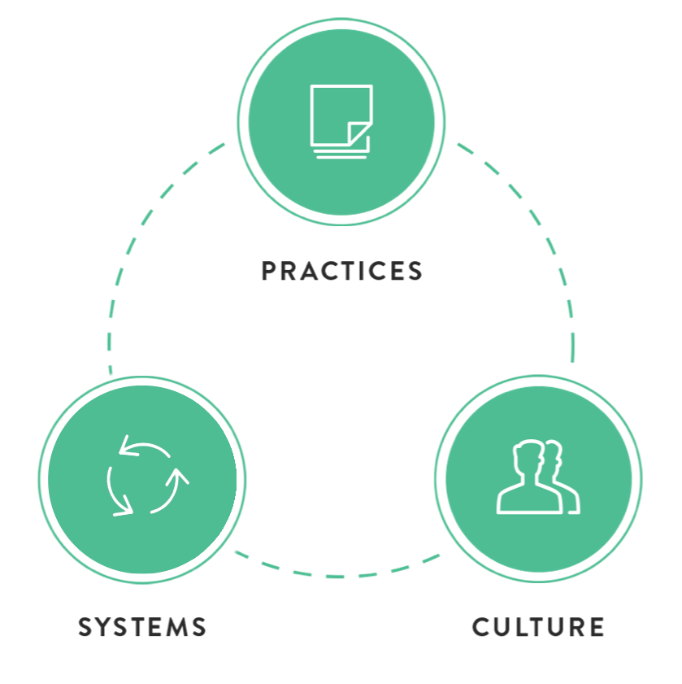

An Integrated Organizational Approach
Integrated Attention To Systems, Practices, and Culture Yields The Best Performance
WHY
Deliver higher impact results
Optimal balance of benefits, investments and risks
WHAT
Setting priorities & sequencing work
Value decomposition & smaller backlog items
Enable collaborative decision-making that focuses on quicker delivery of higher-impact results
Ceremonies and cadences that create efficient collaboration and tooling that optimizes visibility and transparency
WHY
Independent teams with a bias for action
increase the speed and efficiency of how we work
Accelerate decision making
WHAT
Fully allocated resources designated to small cross functional teams
Entities aligned with strategic goals that have agency to make investment decisions
Make tradeoffs so that autonomous teams are empowered to execute across the organization
Establish role clarity and decision rights
Empower the broadest possible execution
WHY
Leverage the collective skills, experience and talent across the enterprise
Bring focus to strategic outcomes
Enable continual improvement
WHAT
Establish cross-functional collaboration
Align with the strong client culture to develop talent and adopt new practices
Embed design thinking into how client works (Adaptive)
CLIENT AGILE ENTERPRISE
As we extend our Agile Enterprise Model and establish agile ways of working across client, the culture that emerges will focus on value, collaborate on success, and build for adaptability.

Slide 4

An iterative rollout
An Iterative Approach with Good Stewardship Creates Quick Wins and Builds Momentum
GENERATE BUY-IN
Develop confidence and trust in new ways of working through quick wins and rapid learning.
Generate engagement by winning hearts and minds to accelerate change adoption.
Run workshops and training to collaborate on role clarity and to situationally tailor practices
Conduct roadshows to communicate practices and ways of working
Develop detailed plans for increment
ENABLE ENTERPRISE COE
Introduce practices and entities tailored precisely to Client’s culture and environment. Architectural decisions about where to tailor things (decision rights, investment decisions) and where things should be locally instantiated to accelerate adoption and progress against business outcomes.
Provide Stewardship of enterprise change
Approaches for scaling and frameworks to encourage rapid and effective adoption by teams
Vision, Planning, Branding
Execution, Staff Development, Coaching
CONDUCT PILOT / NEXT INCREMENT
Deliver immediate business results and create organizational learning
Form teams and execute pilot objectives
Coach for safety and performance
CONFIDENTLY LEAD CHANGE
Start small and produce quick wins with minimal investment while create momentum for large-scale and big-impact change across the enterprise. Provide stewardship and inertia for CHANGING the business and improving the RUNNING of the business.

Slide 5

Our Recommendation for Initial Implementation
ENABLE ENTERPRISE COE (4-5 WEEKS)
STRATEGY AND ROADMAP – Form a guiding coalition, refine and align on the strategy, and develop a clear roadmap.
BRANDING, MEASUREMENT & COMMS – Clear ways to measure and report progress on adoption AND business impact of the change. Definition of the transformation messaging and the communication plan.
TEAM ALIGNMENT AND FLOW – Agreement on a model for establishing teams with appropriate responsibilities (e.g., investment decisions and priorities/tradeoffs). Alignment on a design for the flow of work. Clarity of roles and responsibilities.
TAILORED PRACTICES & PLAYBOOK - The Playbook will consolidate and incorporate Activity Guides, job aids, and training materials detailing the set of practices to be implemented and coached.
PRODUCT AREA ENGAGEMENT MODEL - The engagement model defines the program management approach and escalation model between the Agile COE team and product area teams engaged in transformation.
STAFF DEVELOPMENT AND COACHING – Detailed plan and approach for supporting and coaching team members as they adopt new practices and ways of working.
GENERATE BUY-IN (2-3 WEEKS)
ROLE CLARITY – Workshops to develop clarity and tailor roles. Gain alignment and support for an emerging way of working.
PRACTICES AND TECHNIQUES – Workshops and training to tailor practices, align on techniques, and prepare select teams for initial pilot.
PRELIMINARY TALENT IDENTIFICATION – Fine-tune coaching plans unique to the individual teams and team members that will participate in the pilot.
DETAILED PILOT PLAN – Concrete plan for execution of the pilot, including objectives, measures of success, staffing, and timing.
ROADSHOWS AND READINESS – Create energy and excitement for the change by conducting a series of awareness events and telling a compelling story about the vision and approach. Enlist support and establish feedback and engagement mechanisms.
CONDUCT PILOT (8-9 WEEKS)
DETAILED CHANGE MGT PLAN – Conduct stakeholder analysis and impact mapping, develop individualized engagement plans, optimize for safety.
TEAM FORMATION – Conduct workshops and kick-off sessions to establish final team design and align team members to roles.
METRICS DASHBOARD – Establish metrics dashboard with clear leading indicators around health of the teams. Work with team members and leadership to integrate metrics into day-to-day management routines.
BACKLOG ESTABLISHMENT – Working sessions to establish clear standards for work intake and how to decompose work into prioritized, right-sized, and actionable requirements. Work with team members to progressively elaborate requirements and establish fine-grained clarity of pilot outcomes.
COACH FOR SUCCESS – Operate alongside team members to comfortably develop proficiency in new techniques and practices. Ensure successful delivery of pilot business objectives.
A practical and thorough plan ensures full leverage of existing agile capabilities and establishes frameworks, patterns, and practices that will be proven to work at Client. With active stewardship provided by the EPMO and the Agile COE, teams across the enterprise will be able to quickly, reliably, and enthusiastically embrace new agile ways of working.
THOUGHTFUL IMPLEMENTION

Slide 6
Enable the Client Agile COE
Agile COE Strategy, Framework, and Roadmap
  Partner with the Enterprise PMO to refine and document the strategy and approach for implementing agile at scale within the Client enterprise.
  Establish the COE framework and position the COE to provide stewardship for the journey.
  Design and document the roadmap.
Develop Agile Execution Framework
  Define the Structure (Teams, Roles, Responsibilities), Governance (How work will flow), Metrics (Measurement for Success), and Tooling (Visibility and Transparency across the Enterprise)
  Provide the execution framework that fits the Client culture and allows adaptability across the enterprise
  Define the Client techniques and practices and when they might be used (including, for example, when teams might use Kanban, scrum, etc).
Publish the Client Playbook
  Develop online publication of tools, guides, techniques, and best practices
  Define and Describe the Enterprise System to all participating in the transformation
  Develop and store a standard Client lexicon
Engagement Model (Field Guide) & Scripts
  Define and document how the COE resources interact with the various Product Lines and Teams to prioritize, support, and lead the adoption
  Define and clarify roles and responsibilities for leading change, methods for assessing progress of teams, and ways to report/resolve issues
  Develop outcomes based plans and scripts that lead the teams through the agile adoption journey.
Change Management and Communications Plan
  Establish a Transformation Leadership Team to steward the change
  Establish an Executive Steering Committee to partner with Transformation Leadership Team to jointly set goals and objectives
  Work together to develop a communication approach that keeps people informed and creates safety and awareness around the agile adoption initiative
Transformation Leadership Talent Development
  Clarify job roles, aptitudes, and qualifications that enable successful selection and performance of agile adoption leadership, coaching and consulting
  Use proven methodology for role-based assessments, psychological and aptitude testing to create a solid talent roadmap
BASE FOR EXECUTION
Successful transformations are intentionally led from an aligned point of view. A Center of Excellence provides the organizational ability to develop and maintain clarity in how to execute.

Slide 7
Generate Buy-In and Support for the Journey
Executive Training and Alignment
  Train the executive team on the benefits, impacts and key principles
  Align on strategy and plan and agree on the way of measuring and communicating progress and results
Role Clarity and Team Alignment
  Conduct workshops to develop clarity and tailor roles
  Gain alignment and support for the emerging way of working
Train and Tailor Practices AND Techniques
  Deliver Client specific workshops to train, tailor and align on practices and techniques
  Orient personnel to the Client Agile Execution Framework
  Prepare the selected teams to launch and execute the initial pilot
Roadshows and Readiness
  Conduct roadshows/lunch and learns that will create energy and excitement surrounding the change
  Create awareness, understanding, and safety about the vision and approach
  Enlist support and establish feedback and engagement mechanisms
Talent Identification and Team Assessments
  Fine-tune coaching and training plans unique to individual teams and team members that will participate in the pilot
  Utilize data from team assessments and testing to precisely target training and coaching opportunities
Detailed Pilot Plan
  Develop the concrete plan for executing the pilot
  Include the objectives, measures of success, staffing model, and timing
BROAD BASED CONSENSUS
Bring a shared understanding to why the organization is doing agile, what the underlying approach to agility is, and how to implement and sustain the changes is required to move the organization to the new model.

Slide 8
Conduct Pilot and Demonstrate Results
Form and Train Teams
  Conduct workshops and kick-off sessions
  Align team members to roles
  Provide training unique to the needs of each team
Implement Metrics Dashboard
  Establish a Metrics Dashboard providing clear leading indicators around the health of the teams and transformation progress
  Work to integrate these metrics into the daily management routines
Establish & Maintain Clarity of BacklogS
  Establish clear standards for work intake
  Determine how to decompose that work into prioritized, right-sized and actionable requirements
  Work with team members to progressively elaborate those requirements and establish clarity of expected outcomes
Coach for Success
  Operate alongside team members to comfortably develop proficiency in the new techniques and practices
  Ensure successful delivery of pilot business objectives
Implement Plans and Progress Reports
  Progressively elaborated 90-day plan specifies the teams involved, activities to be performed, and business outcomes to achieve
  Plan is informed by the metrics and team assessments
  Progress reports will report against the plan to demonstrate movement and identify impediments to the transformation
Capture Enterprise Learnings: Adapt the Agile Execution Framework and Adoption Approach
  Intentionally observe results and leverage learnings to identify and prioritize additional improvements
VALIDATE THE MODEL
Initially executing the change approach to implement the agile model ensures that alignment exists in the organization and hardens the processes to the point the can be rolled out at scale.

Slide 9

A Structure for this Engagement
Leading Agile Team ROLES
EXECUTIVE ACCOUNT LEAD– A senior executive with more than 25 years of agile and organizational development experience, the Executive Account Lead partners with Client executives to establish and maintain overall strategy and direction for the engagement. This person is responsible for creating the space and conditions required for the transformation teams to operate, and they have overall fiduciary responsibility to Client and LeadingAgile.
Enterprise Transformation Lead – The Transformation Lead is a principal or managing consultant who leads execution. The TL partners with Client transformation leadership and the Executive Account Lead to maintain the plan and provide day-to-day direction. As an expert in the agile enterprise, the TL identifies tactics and aligns the efforts of the transformation team. They also facilitate ESC and TLT meetings, build outcomes-based plans, and oversea planning cadences and progress reporting.
Enterprise Agile Transformation Consultant - Senior consultant responsible for team and technique coaching. These consultants are experts in agile practices and in methods for helping teams and individuals safely adopt those practices.
Engagement Analyst – This person is invaluable to the smooth execution of the engagement and is responsible for deliverables such as activity guides, job aids, and other playbook artifacts. They help to establish metrics collection and progress reporting, and they interface with the LeadingAgile design and brand team to ensure outputs are aligned with the Client brand.
Engagement design
The core of this engagement is a series of workshops that create the alignment, skills, and proficiencies required to achieve the transformation outcomes. Every couple of weeks, we’ll conduct discovery and prepare a workshop, execute the workshop, and establish new organizational capabilities. This pattern will also inform and direct training and coaching activities to build new skills. LeadingAgile will deploy skilled consultants, coaches, and trainers as required to to provide all the workshops, training, coaching, deliverables, and activities of this engagement.
ENGAGEMENT DURATION
FOUR – FIVE MONTHS
OVERALL COST
$370,000
REALIZING THE PLAN
LeadingAgile and Client will partner to align the agile vision and build the ecosystem that helps it become reality.

